Slide 1
KANBAN

Slide 2
What is Kanban?
Kanban is the result of practitioners applying lean principles to software engineering.
Kanban is influenced heavily by existing first- generation Agile methodologies.
Kanban is more like a tool than a methodology.

Slide 3
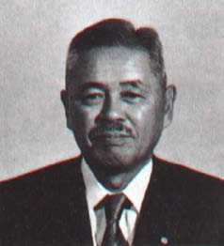
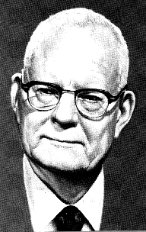
What is Kanban?
It starts with Lean Principles:
Pull
Continuous Flow
Customer Value
Waste Elimination
Continuous Improvement
Founder of Toyota
Production Systems
Taiichi Ohno
Quality Guru: System of Profound Knowledge
W. Edwards Deming

Slide 4

What is Kanban?
Kanban for Software’s Lean Heritage:
Don’t build features that nobody needs right now
Don’t write more specs than you can code
Don’t write more code than you can test
Don’t test more code than you can deploy

Slide 5
Value Stream
Your value stream could be something like:
Request → Analysis → Dev → Verify → Release

Slide 6
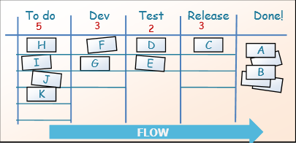
Kanban in a nutshell
Visualize the workflow
Limit WIP (work in progress)
Measure & optimize flow

Slide 7
Kanban Pull and Flow
Phase-based development (waterfall) transfers the entire batch from state to state.
Existing Agile development transfers small batches from state to state (iterations).
Our goal with Kanban is to transfer one piece at a time (one piece flow), or at least work in that direction.

Slide 8
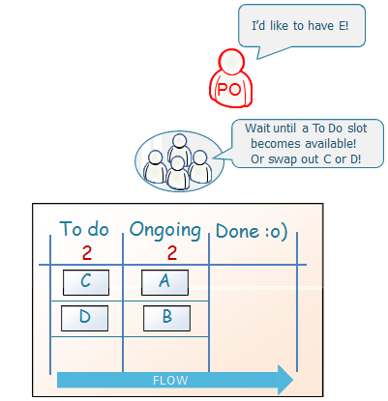
Kanban
Kanban is allow change in mid-iteration

Slide 9




































Kanban teams
Kanban teams need just a few metrics and tools to be effective:
- Cycle time
- Lead time
- Cumulative Flow Diagrams
Kanban – example 1
Kanban – example 2
Specialist
Cross-functional team
Specialist team
Cross-functional team

Slide 10
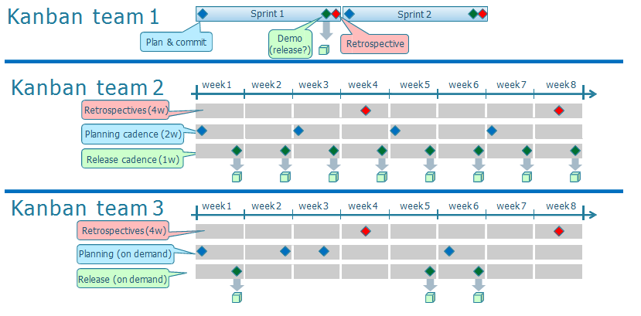
Kanban teams

Slide 11
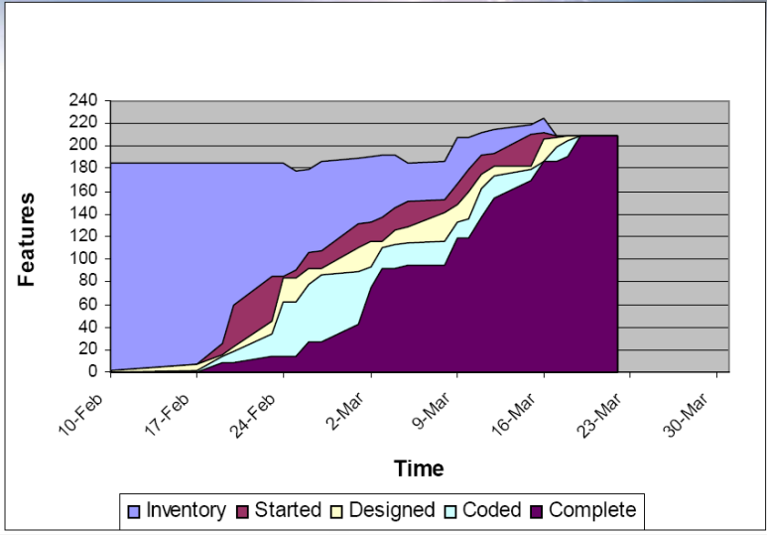
Use cumulative flow diagrams to visualize work in progress

Slide 12
Additional Considerations
Focus on system, not individual performance.
Kanban as a change management tool – evolution not revolution.
Achieve predictability by not asking developers to predict!
Know your true WIP!

